Slide 1
Big Conflicts:
The ethics and economics of privacy in a world of Big Data
Ross Anderson
Cambridge

Slide 2
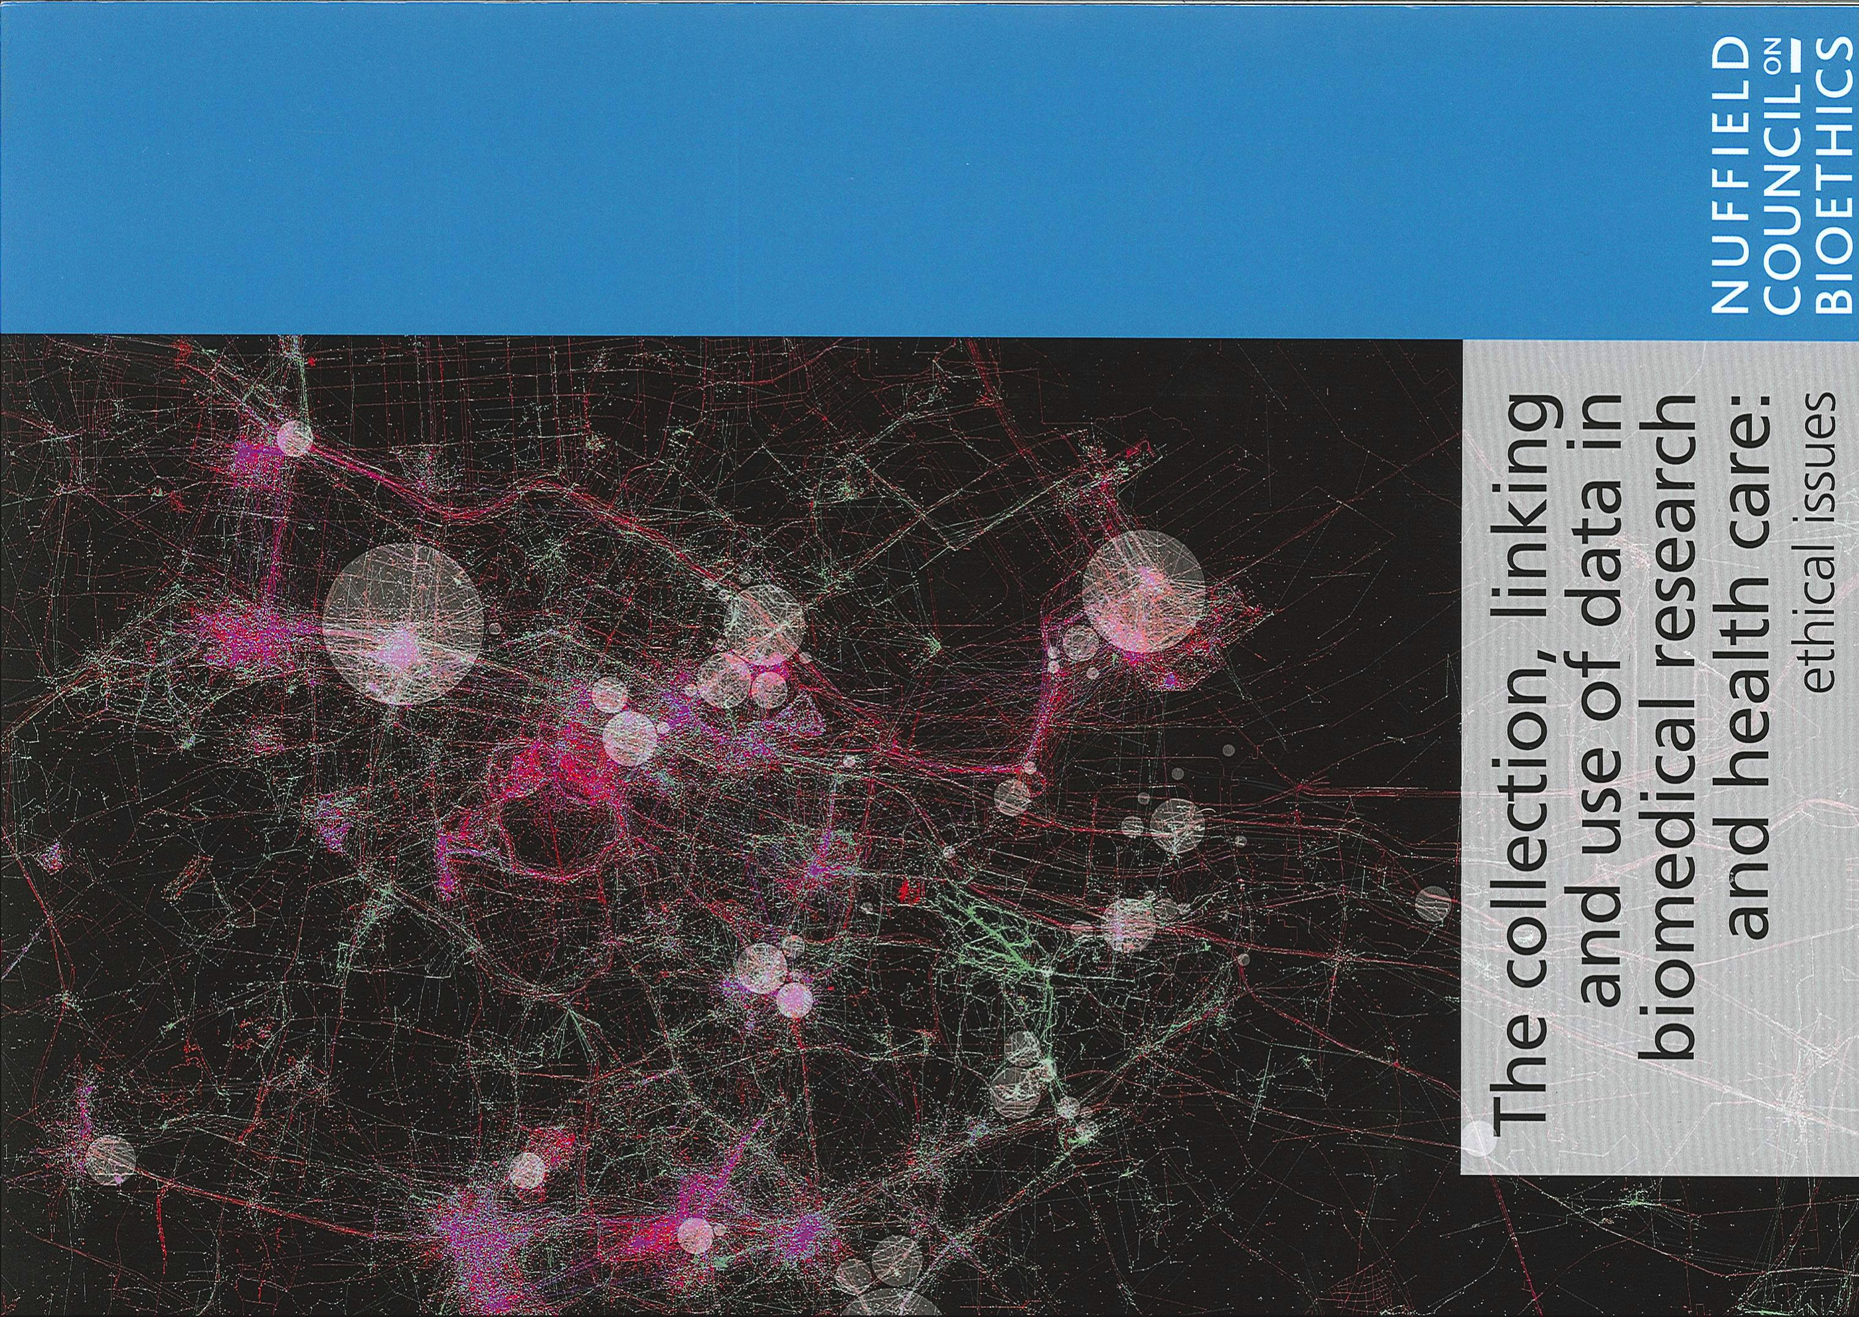
The Nuffield Biodata report
What happens to medical ethics in a world of cloud-based health records and pervasive genomics?
12 authors: from IT, medicine, ethics, insurance, pharma …

Slide 3
‘Big Data’ comes to the NHS
Cameron policy announced January 2011: make ‘anonymised’ data available to researchers, both academic and commercial, but with opt-out
We’d already had a laptop stolen in London with 8.63m people’s ‘anonymised’ records on it
In September 2012, CPRD went live – a gateway for making anonymised data available from secondary care, run by the MHRA (the regulator)
They refused to answer a FOI request about anonymisation mechanisms!

Slide 4
Can an NHS patient opt out?
Cameron had promised in 2011 that our records would be anonymised, and we’d have an opt out
The Secretary of State for Health, Jeremy Hunt, assured us in March 2013 that existing opt-outs would be respected
In July this was reversed by the NHS England CIO
NHS opt-out defaults are wrong; the privacy mechanisms are obscure; and they get changed whenever too many people learn to use them

Slide 5
The care.data scandal
Hospital Episode Statistics (HES) has records going back 15 years (about a billion in total)
Apr 2014: HSCIC reveals that HES data sold to 1200 universities, firms and others since 2013
HESID usually contains postcode, dob
Even if the HESID were encrypted, what about cardioversion, Hammersmith, Mar 19 2003?
Yet the DoH described pseudonymised HES data as “non-sensitive” and the ICO agreed!

Slide 6
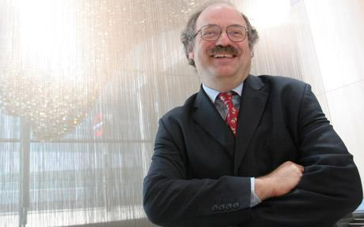
Advocating anonymisation

Slide 7
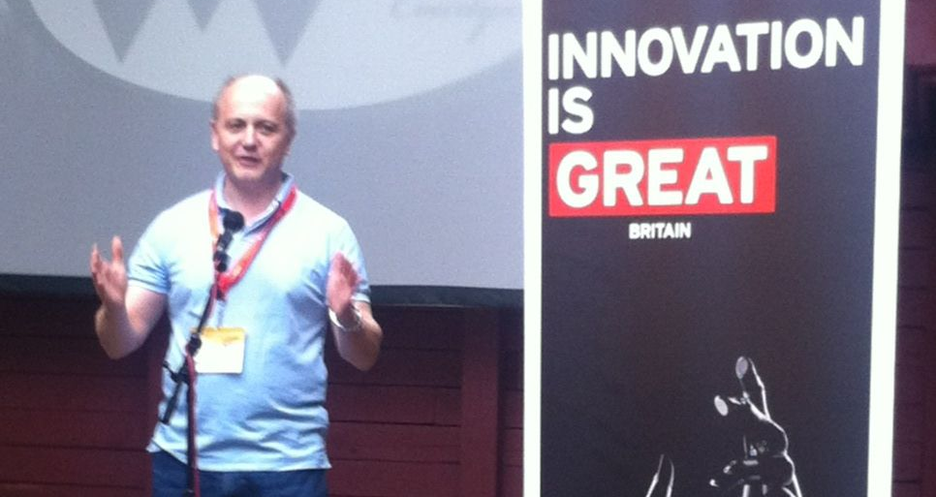
… and transparency

Slide 8
Now add DNA
The UK Department of Health is launching a ‘100,000 genomes’ project to use genetic analysis in both direct care and research
All sequence data centralised; consent to unlimited research use (including sharing with 23andme) or you can’t join
The FDA just stopped 23andme from offering health advice to new customers
After the election: 50 million genomes!

Slide 9
The PCAST report
Presidential Council of Advisers on Science and Technology (Craig Mundie, Eric Schmidt…)
Big data has three components, they say
  Collection (e.g. your kid’s teddy bear)
  Aggregation (Microsoft / Facebook / Google)
  Use (the firms that buy ads)
Claim: only the third should be regulated!
ECJ response in González, the very same week

Slide 10
An ethical approach
It’s long been accepted in medicine that the law’s boundaries are way too wide
If you do everything you can’t be jailed or sued for, you’ll quickly lose patients’ trust
So what is an ethical approach to medical practice, and medical research, in a world of cloud-based health records and genomics?
Nuffield Bioethics Council set up a project …

Slide 11
Problem (1)
There’s lots more data
  Cloud-based primary and secondary care records
  Genomics: from 100,000 patients to 50 million?
  Patient-generated stuff like fitbit
  Comms data, lab data, all sorts of other stuff …
And lots more capability to store & process it
This leads to all sorts of initiatives that mash up data from previously siloed applications

Slide 12
Problem (2)
Huge ‘Big Data’ hype bubble – policymakers terrified of looking technophobic
Shortage of money drives innovation in public sector, just as plentiful VC in the private sector
Centralising tendency of every bureaucracy
‘Open data’ promise to big pharma and to nonprofit research communities
Anonymisation – a ‘broken promise of privacy’ (see my book and ODI, RSS talks)

Slide 13
Moral values and interests
Distinction between public and private evolved over millennia – before history
Norms of disclosure are important for formation and maintenance of identity and relationships
Consent is how patient relationships work
Public interests exist such as public health and research but these are not just in opposition to private interests in confidentiality

Slide 14
Law and governance
Laws reflect emerging social consensus (albeit with a time lag and a big lobbying bias)
  Common law duty of confidence
  Data protection law
  Human-rights law: s8 ECHR, I v Finland
Usual take: ‘consent or anonymise’
But anonymisation doesn’t work, and consent is becoming steadily harder!
What should an ethical researcher do?

Slide 15
Principle 1 – Respect for persons
The set of expectations about how data will be used in a data initiative should be grounded in the principle of respect for persons
This includes recognition of a person’s profound moral interest in controlling others’ access to, and disclosure of, information relating to them held in circumstances they regard as confidential

Slide 16
Principle 2 – Human rights
The set of expectations about how data will be used in a data initiative should be determined with regard to established human rights
This will include limitations on the power of states and others to interfere with the privacy of individual citizens in the public interest (including to protect the interests of others)

Slide 17
Principle 3 – Participation
The set of expectations about how data will be used (or re-used) in a data initiative, and the appropriate measures and procedures for ensuring that those expectations are met, should be determined with the participation of people with morally relevant interests
Where it is not feasible to engage all those with relevant interests, the full range of relevant interests and values should nevertheless be fairly represented

Slide 18
Principle 4 – Accounting for decisions
A data initiative should be subject to effective systems of governance and accountability that are themselves morally justified
This should include both structures of accountability that invoke legitimate judicial and political authority, and social accountability arising from engagement of people in a society
Maintaining effective accountability must include effective measures for communicating expectations and failures of governance, execution and control to people affected and to society more widely

Slide 19
How do existing initiatives add up?
HES/care.data – treating data as an industrial raw material, for sale to all, and available with commercial reuse licenses
CPRD – won’t say how data are ‘anonymised’ and push it for all sorts of research purposes
100,000 Genomes – at least GeL keep custody of the data but allow secret uses by firms
Scotland – links local datasets using a central `safe haven’; some public engagement

Slide 20
Application to security research?
Started thinking about this following Facebook app from our psychology department
Our Device Analyzer runs on 23,000 Androids
For user: personal analytics (best phone plan)
For us: understanding smartphone use, energy consumption and much else
See https://deviceanalyzer.cl.cam.ac.uk/ which has research papers etc

Slide 21
Application to law enforcement?
Law enforcement at least has some focus on respect for persons (even if intel doesn’t)
It’s bound by human-rights law ( ditto )
Thanks to Edward Snowden, we have a more truthful account of state surveillance capabilities but are still not really consulted (see DRIP Bill, ISC mess, …)
In an ideal world, we’d have an international treaty on warrants, transparency, jurisidiction

Slide 22
Today’s ‘Economist’
“If citizens aren’t protected from prying eyes, some will suffer and others turn their backs. Societies will have to develop new norms and companies learn how to balance privacy and profit. Governments will have to define what is acceptable. But in eight short years smartphones have changed the world—and they have hardly begun.”

Slide 23
Where’s it going?
“The Ood, it is worth remembering, did not just have two brains, one in the head and one in the hand—they had a third, planetary brain, telepathically shared by all. It may yet be to such a world that, with phones in hand, pocket and purse, humanity makes its way.”

Slide 24
Where’s it going?
“The Ood, it is worth remembering, did not just have two brains, one in the head and one in the hand—they had a third, planetary brain, telepathically shared by all. It may yet be to such a world that, with phones in hand, pocket and purse, humanity makes its way.”
“Democracies may be able to find acceptable solutions to some of the problems posed.”

Slide 25
More …
The report: see our blog or my website
Our blog
http://www.lightbluetouchpaper.org
My website
http://www.ross-anderson.com/
Workshop on the Economics of Information Security, Delft, June 22–3
http://weis2015.econinfosec.org/

